Slide 1
Migration of Indian Students and Professionals (2020–2023)
A Data-Driven Overview
Debapriya Nayak

Slide 2

Introduction
Purpose of the study
Key focus: Student and professional migration trends
Time span: 2020 to 2023

Slide 3
Data Sources
- Ministry of External Affairs (India)
- International Labour Organization (ILO)
- News reports and government portals
- Monthly data based on yearly distribution

Slide 4
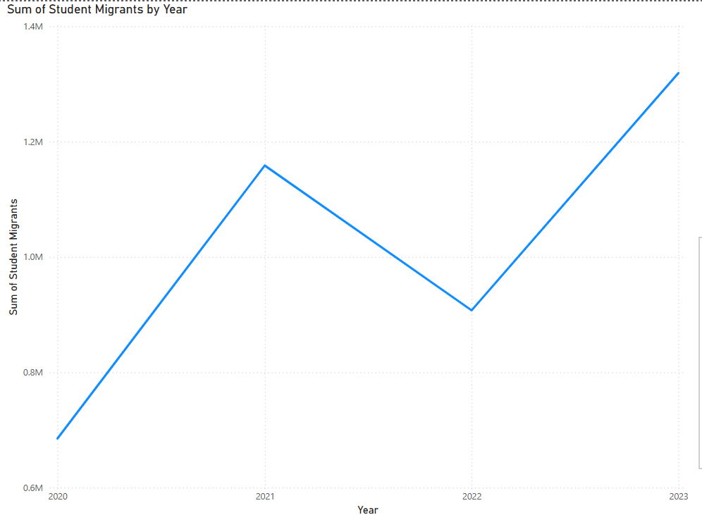
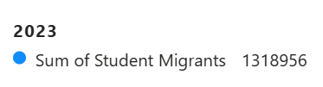
Migration Trends: Students
Line chart of monthly student migrants (2020–2023)

Slide 5
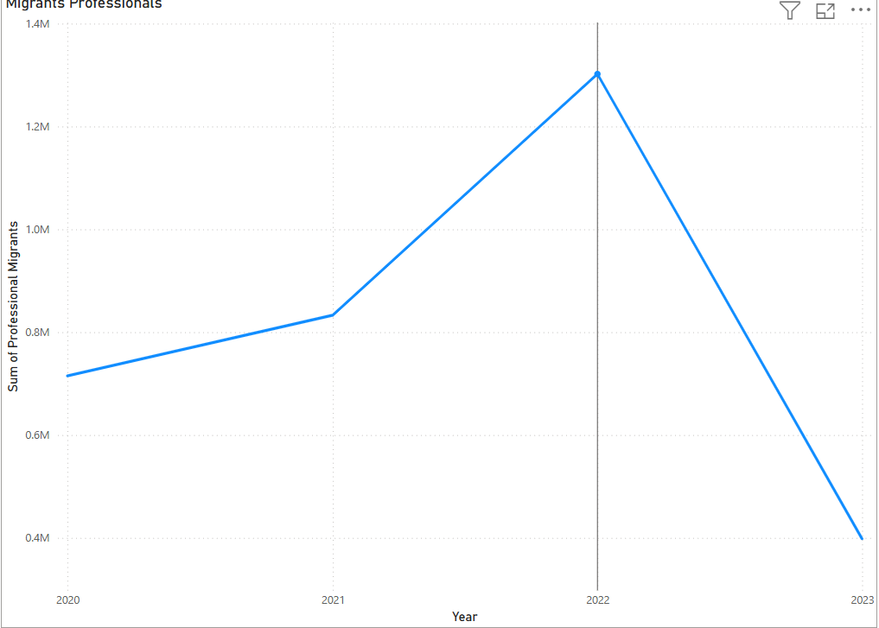
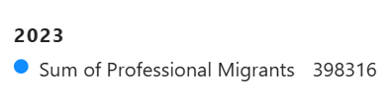
Migration Trends: Professionals
2020–2023
Line chart of monthly professional migrants
2023
Highlight 2023 drop and missing 2024 data.

Slide 6

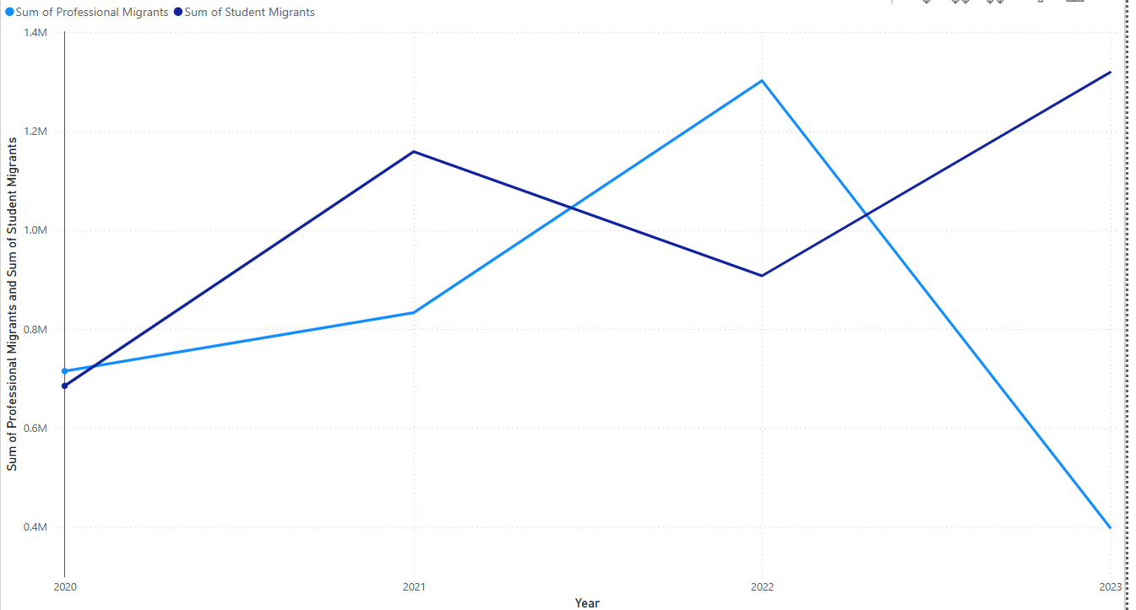
Combined Trends
Dual-line chart comparing both categories.
Useful for forecasting using Power BI.

Slide 7
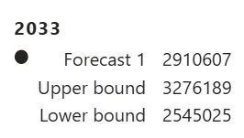
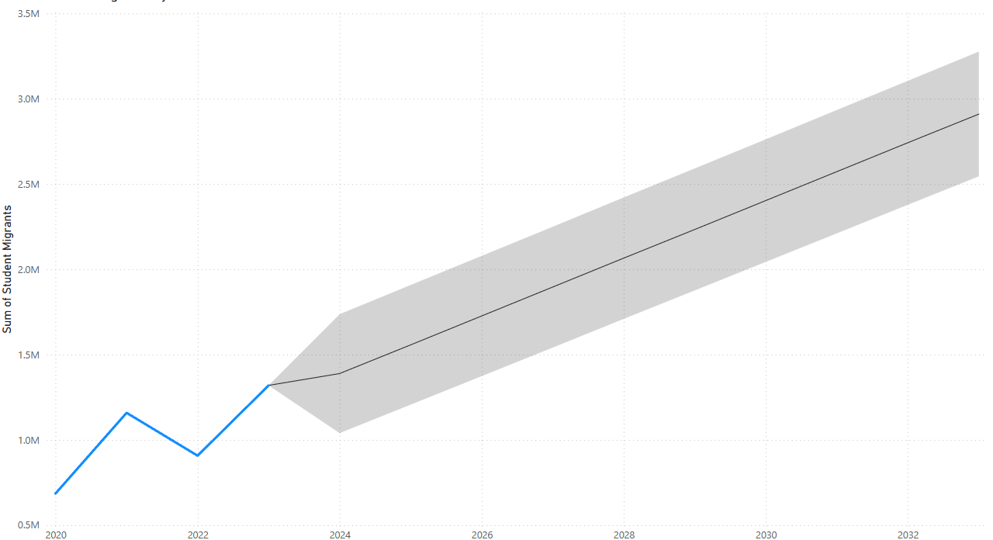
Forecasting Migration for Students till 2033
Power BI forecasting using Data

Slide 8
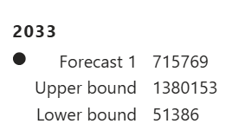
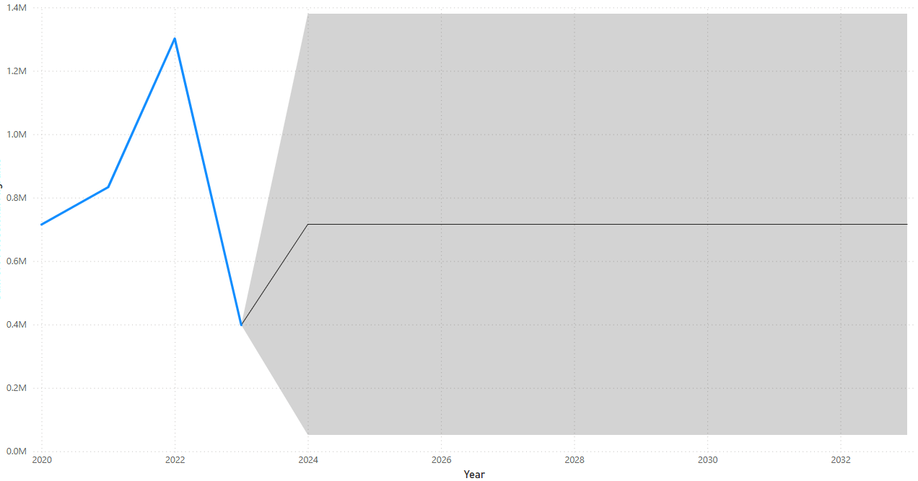
Forecasting Migration for Professionals till 2033
Power BI forecasting using Data

Slide 9
Reasons for Migration – Students & Professionals
Students
Access to high-quality international education
Better career prospects and global exposure
Favorable immigration and post-study work policies
Limited advanced research and course options in India
Professionals:
Higher salaries and improved living standards
Skill-based job opportunities in tech, healthcare, and engineering
Demand for global talent in developed countries
Career growth, better work environment, and stability abroad

Slide 10

Conclusion
Student migration increased steadily post-COVID, peaking in 2023
Professional migration fluctuated, with a sharp drop in 2023
USA, Canada, and UK remained top student destinations
UAE and USA led in professional migration
Forecasts suggest continued student growth; professionals may rebound

Slide 11
Thank You!

